Slide 1

BS Session: The magic behind Application Testing

Slide 2
Summary
Introdcution : Why, Pymarid of testing
Unit test (What is a unit test ?, why (piéce d'usine)? How to do unit tests ( tools ))
Component test (What is a unit test ?, why (piéce d'usine)? How to do unit tests ( tools ))
Integration test (What is a integration test ?, why (module test )? How to do integration tests ( tools ))
TDD ( what ? Why ? How ?)
Testing tools (unittest) vs testing frameworks (Pytest) [advantage, cons, when to use]
good practice

Slide 3

INTRODUCTION

Slide 4
Testing ? WHY ?
1-Security (Data Protection, Compliance)
1
2-Bug and Error Detection (Early Identification, Error-Free Software)
2
4-Quality Assurance (Functionality, Performance)
4
5-Cost and Time Efficiency (Preventive Measures,Efficiency)
5
3-User Experience (Usability, Reliability)
3

Slide 5
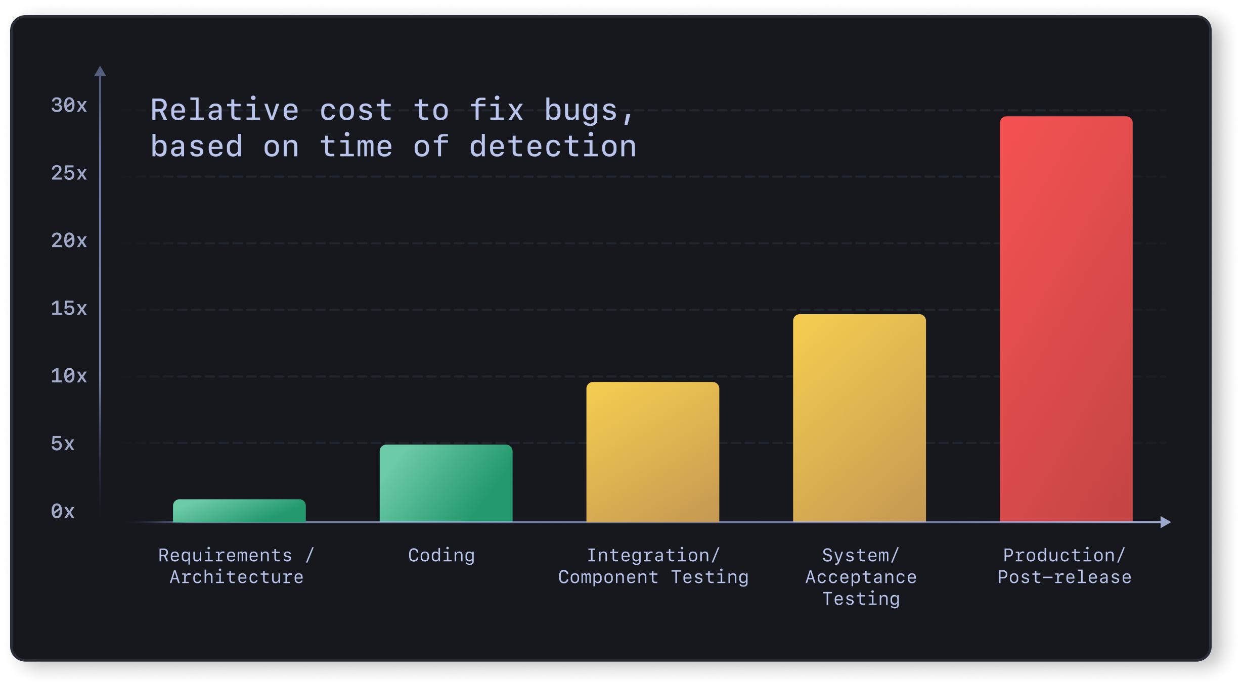
Testing ? WHY ?

Slide 6
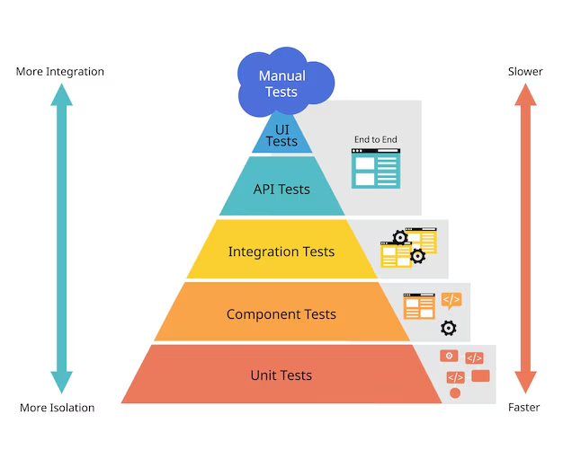
The great PYRAMID

Slide 7
UNIT TEST

Slide 8
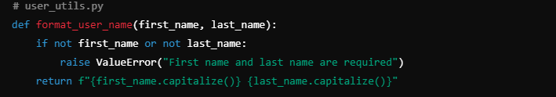
What is a unit?
Why testing it ?
Ensure that the smallest functional granularity of the application fulfills its role properly,
we must not forget that it is by combining theses units that we create the big components of the
application.

Slide 9
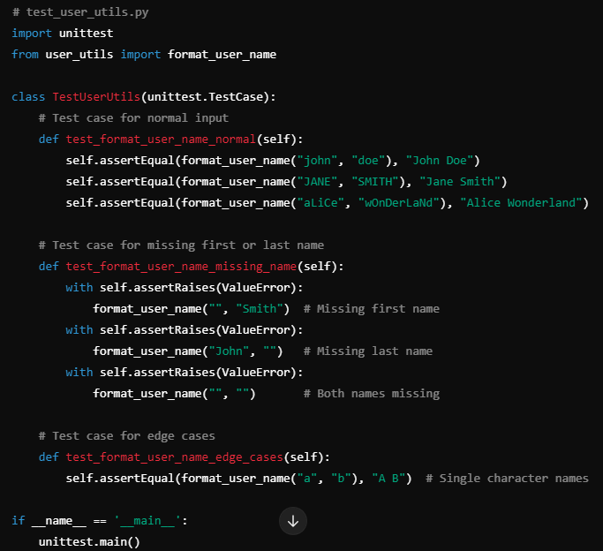
how ?

Slide 10
Component test

Slide 11
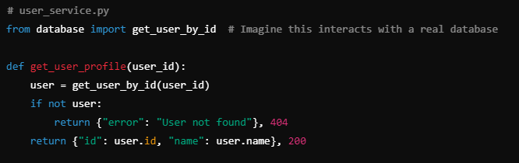
What is a component?
Why testing it ?
Component tests aim to ensure that parts of the application function correctly at a medium level of granularity, using mocks to isolate them
Like factory-made parts, these components must be thoroughly tested, as they form the foundation of the application, and their high rate of reuse demands maximum reliability.

Slide 12
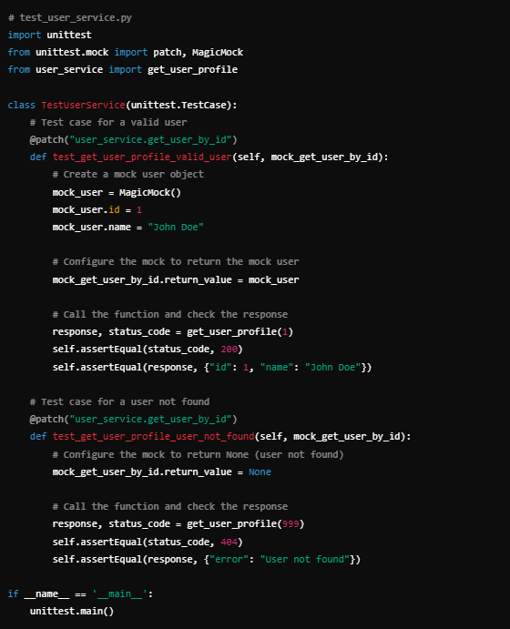
how ?

Slide 13
IntEgration test

Slide 14
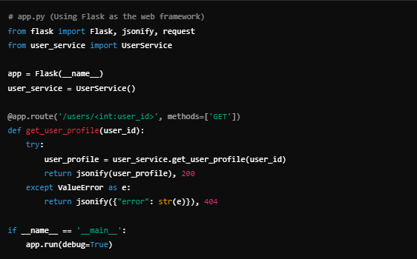
What is an integration?

Slide 15
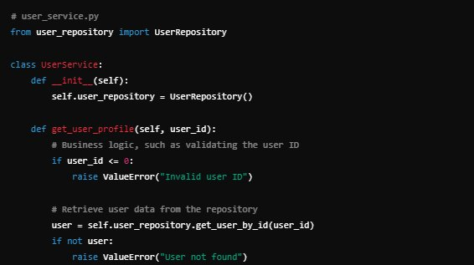
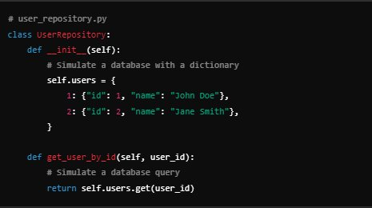

Slide 16
Why testing it ?
Verify that different components or systems within an application work together as expected
Testing each feature behavior to ensure that each essential process are working correctly and meets its use case.

Slide 17
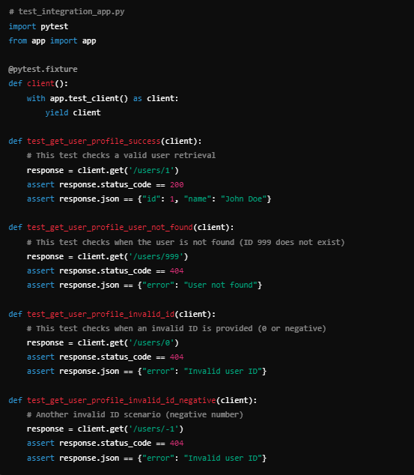
how ?

Slide 18
TEST DRIVEN DEVELOPMENT

Slide 19
What?
Is a software development approach in which tests are written before the code that implements the desired functionality.
Why ?
The core idea behind TDD is to use tests to guide the design and development of the software.
It ensures that your codebase is well-tested, and it promotes writing simple and efficient code that meets the specified requirements.

Slide 20
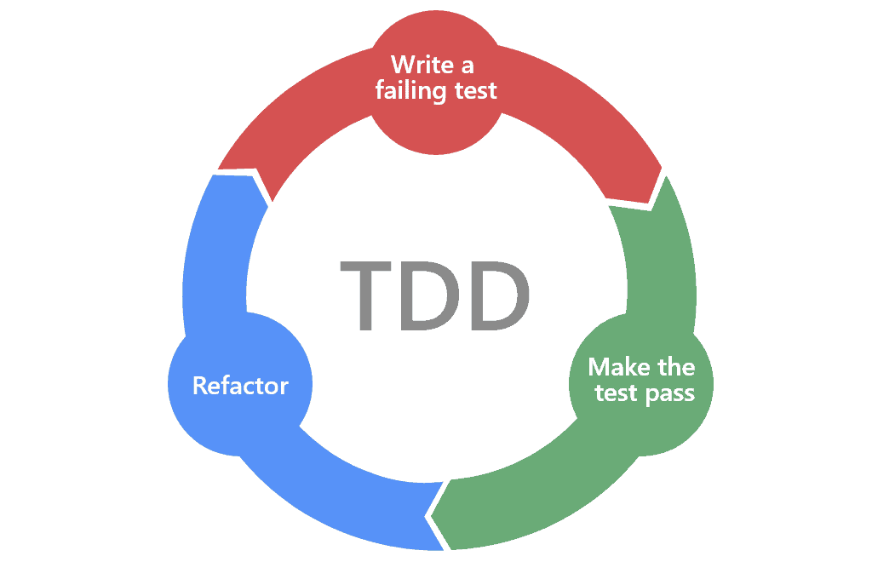
how ?
Step 1: Start by writing test that matches the requirements (speficiations)
Step 2: Run the test, an it has to fail to make sure you are adding something new
Step 3: Wrtie the simples code so that the tests pass
Step 4: Make all tests pass
Step 5: Refactor and Improve code

Slide 21
Normal developement vs TDD
Feature | Normal Development | TDD (Test-Driven Development)
Starting Point | Code first, test later | Test first, code later
Focus | Feature implementation | Behavior and functionalit
Testing | Often reactive | Proactive, test-driven
Code Quality | Variable | High-quality, clean, and modular
Debugging | Longer, post-implementation | Quicker, caught early
Speed | Faster short-term | Faster long-term
Maintenance | Higher technical debt | Lower technical debt
Risk of Bugs in Production | Higher | Lower

Slide 22
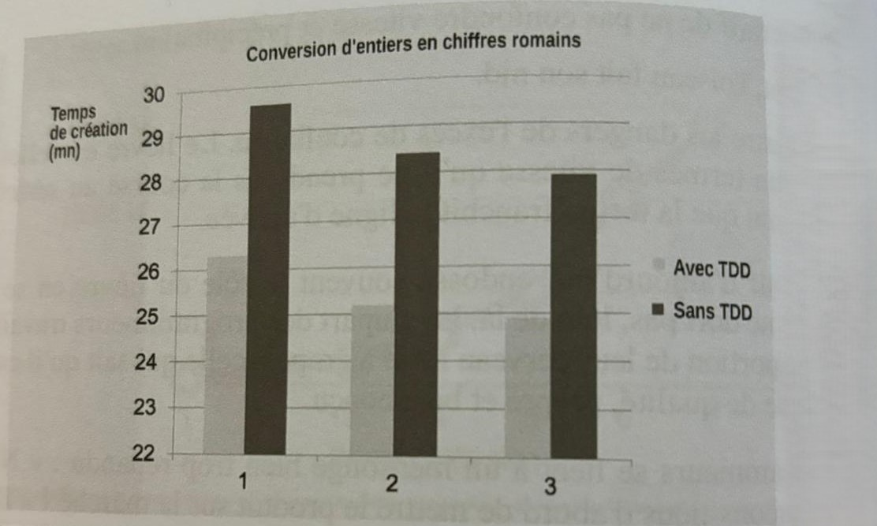
Normal developement vs TDD

Slide 23
FRAMEWORKS and tools
Pytest : Testing Framework
pytest-fixtures: A setup required for running tests
unittest.mock: mock classes methods services and other components with unittest.mock
Monkeypatch fixture: Sometimes necessary when dealing with external code you have no control over
Faker: A dynamic data generation (use it with seeds)
pytest-postgresql: Allows spinning up temporary databases for integration testing.
pytest-cov: Provides detailed coverage reports.

Slide 24
good practice
Write Tests with Clear and Descriptive Names (with test_ prefix)
Organize Tests into Modules and Classes (Group related tests into modules and classes to maintain a logical structure.)
Use pytest Fixtures for Setup and Teardown
Make Tests Independent and Isolated
Use Assertions Effectively (Avoid complex or multiple assertions in a single test, as they can make it difficult to diagnose failures)
Mock External Dependencies ( Use mock template to uniformise mocking structure for each type of mocks )
Use instance based temp. testing databases (pytest-postegree)

Slide 25
good practice
Use Parametrized Tests for Repeated Logic (e.g: @pytest.mark.parametrize() decorator )
Aim for Fast, Lightweight Tests ( mark time consuming test separately so they can be excluded from frequent test runs)
Maintain Code Coverage
Write Testable Code (Write functions and classes that are modular, single-responsibility, and easy to test)
Handle Exceptions and Edge Cases (Test for edge cases and exceptional scenarios (e.g., empty inputs, invalid data) to ensure code robustness.)
Avoid Over-Mocking and Over-Testing (Focus on testing meaningful logic in each component rather than testing every minor detail, especially if it’s already covered by other tests)

Slide 26

Thank you

